Slide 1
COMMERCE DATA USABILITY PROJECT
Notes:
Background blue = #265994

Slide 2
Commerce agencies are among the biggest contributors to the open data movement.

Slide 3
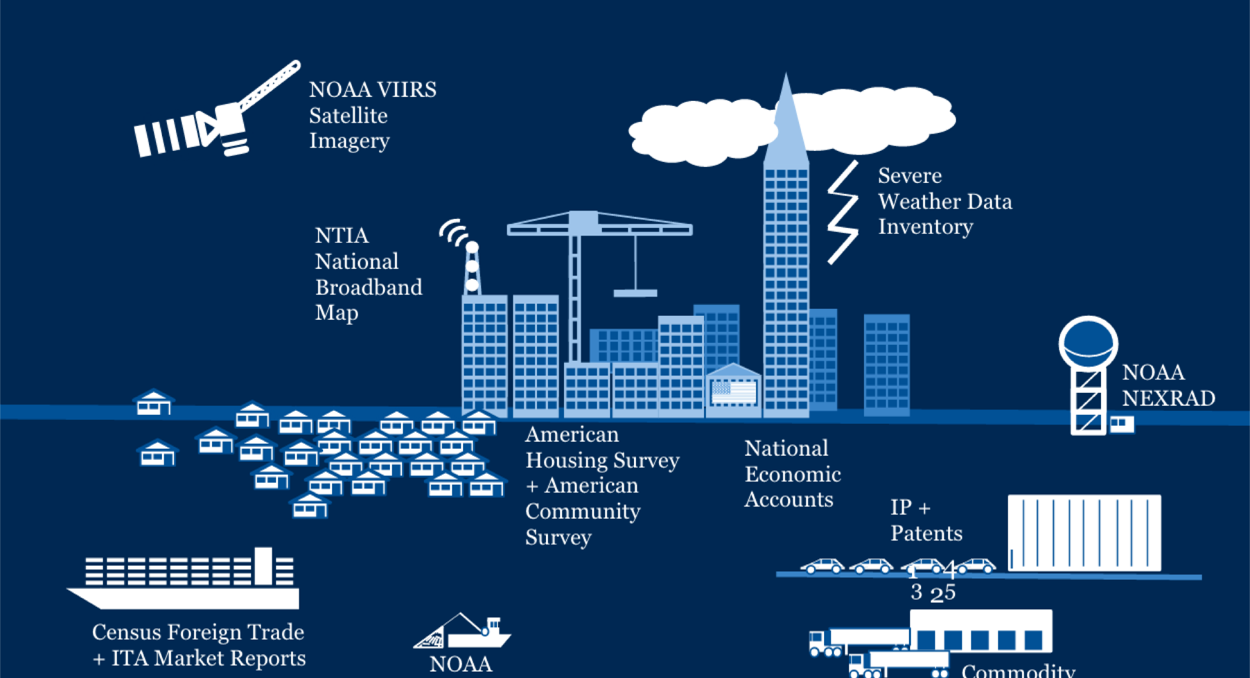
Notes:
And under one roof we cover everything from population dynamics to space flight.

Slide 4

Just from one instrument on one of our satellites, we collect, process and disseminate >2.5 TB per day.

Slide 5
But what can you do with that information? What can we do to encourage data use and data-drivenness?

Slide 6
Notes:
It’s great that we’ve put data out in the open. Well over 65,000 datasets a matter of fact.

Slide 7
narrative
research questions
code
visuals
context
“show the thing”
algorithms
Notes:
Our research with users found that we need to furnish an experience.

Slide 8
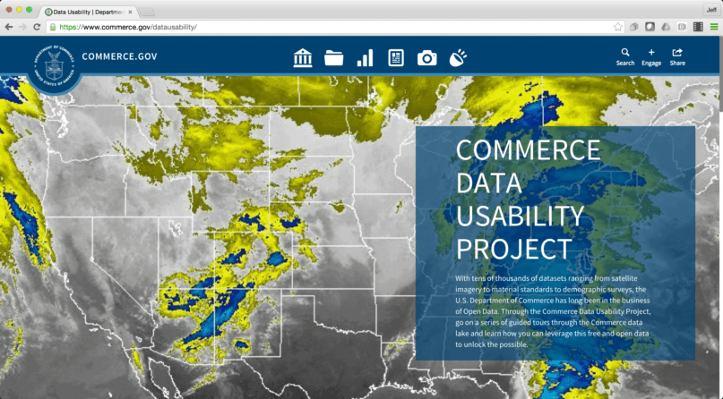
commerce.gov/datausability
Notes:
And to do so, we’ve collaborated with private sector, academia and nonprofits to show how data is used from their perspective. And the bench of contributors is growing.
Recently,
- Mapbox has contributed two tutorials on how to get started with interactive web maps using NOAA Global Weather Forecast data;
- Zillow has produced a tutorial on analyzing housing affordability combining their data and Census data;
- Earth Genome illustrated how to manipulate digital elevation model data that plays a key role in wetlands models.

Slide 9

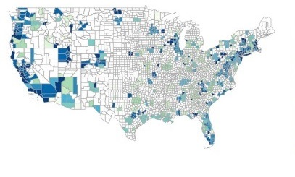


Notes:
That’s why we’ve created the Commerce Data Usability Project. We are

Slide 10
DEMOS
Notes:
There’s no better way of showing the value than by showing the thing. Make sure Tonja knows there is a demo session
Scroll through Zillow’s – 4 points max (thanks to contributor, why, what it is, how awesome it is)
Scroll through Hail storms – 4 points max (hail causes lots of damage, turns out noaa has a lot of data to help understand risks, we put together code to process down the data into understandable chunks, and the code is all available. Advanced uses can be used for risk management and safety research)

Slide 11







Notes:
We’ve partnered with private sector companies, academia, and nonprofits to show how data is being used around the country.

Slide 12
8 published
12 + tutorials in the pipeline
Notes:
We have 40 projects with some big ones on the way

Slide 13
Stay tuned.
Notes:
We have 40 projects with some big ones on the way

Slide 14
Pri Oberoi / Data Scientist
poberoi@doc.gov

